Slide 1

Cost Volume Profit Analysis
Information for decision-making
Instructor:
Prof. Dr. B. Gültekin Çetiner
Website: http://elearning.drcetiner.com
drcetiner@gmail.com Prof. Dr. B. Gültekin Çetiner

Slide 2
Cost-Volume-Profit Analysis
Cost-volume-profit analysis is an important tool used by managers to study the relationships between total revenues and total costs and volume of activity and to make appropriate decisions which directly impact profits.
Specifically CVP analysis looks as the relationship between:
Selling prices of products
Output level
Variable cost per unit
Total fixed cost
Sales mix
drcetiner@gmail.com Prof. Dr. B. Gültekin Çetiner

Slide 3
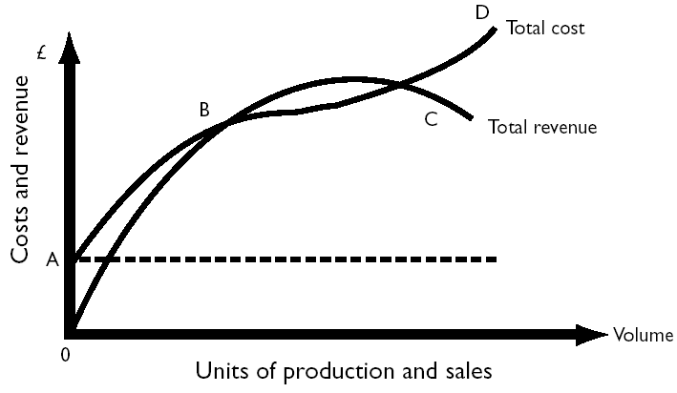
Economist’s cost-volume graph
Economist’s cost-volume graph
1. Curvilinear graph results in two break-even points.
2. Note the shape of the total cost function:
• initial steep rise, levels off, followed by a further steep rise.
3. The total revenue line initially rises steeply,then levels off and declines.
drcetiner@gmail.com Prof. Dr. B. Gültekin Çetiner

Slide 4
The accountant’s cost–volume–profit model
Constant variable cost and selling price is assumed.
Only one break-even point,and profit increases as volume increases.
The diagram is not intended to provide an accurate representation for all levels of output.The objective is to provide an accurate representation of cost and revenue behaviour only within the relevant range of output.
drcetiner@gmail.com Prof. Dr. B. Gültekin Çetiner

Slide 5
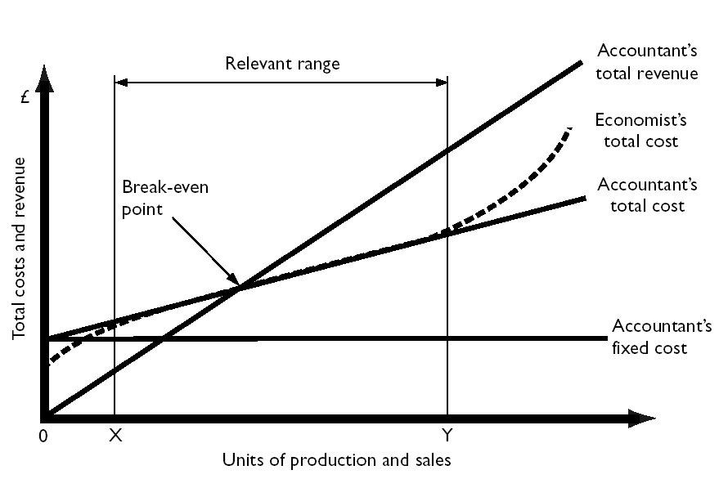
The accountant’s cost–volume–profit model
drcetiner@gmail.com Prof. Dr. B. Gültekin Çetiner

Slide 6
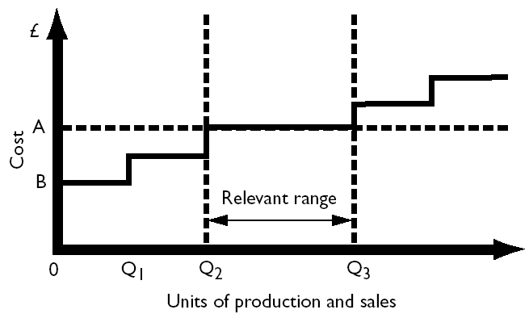
Accountant’s fixed cost function
Within the short term the firm anticipates that it will operate between output levels Q2 and Q3 and commits itself to fixed costs of 0A.
Costs are fixed in the short term, but can be changed in the longer term.
drcetiner@gmail.com Prof. Dr. B. Gültekin Çetiner

Slide 7
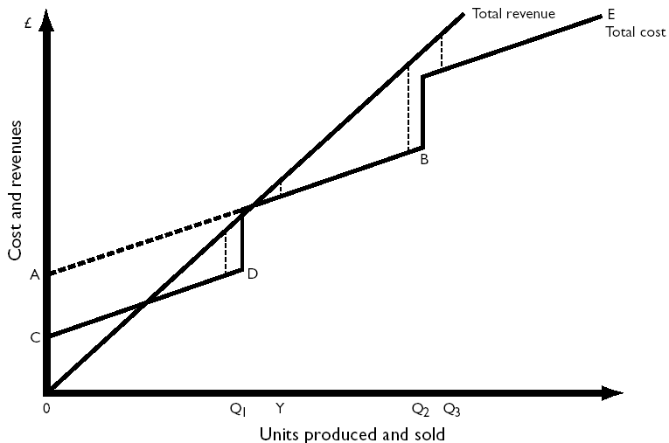
Changes in fixed costs
drcetiner@gmail.com Prof. Dr. B. Gültekin Çetiner

Slide 8
Changes in fixed costs
At the planning stage the firm must decide on how much productive capacity should be provided and,therefore,the level of fixed costs.
If maximum sales levels are 0Q1,0Q2 and 0Q3,then profits are maximized at output level 0Q2.
The firm will choose to provide capacity of 0Q2 and will operate on total cost line AB during the next period.
drcetiner@gmail.com Prof. Dr. B. Gültekin Çetiner

Slide 9
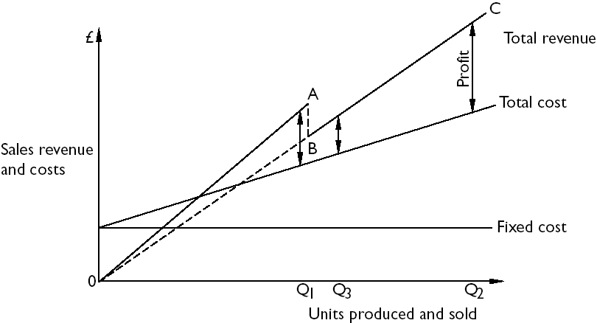
Changes in selling price
drcetiner@gmail.com Prof. Dr. B. Gültekin Çetiner

Slide 10
Changes in selling price
At the planning stage prior to setting selling prices for the forthcoming period,the firm is considering whether to reduce the selling price in order to increase demand.
The potential revenue functions are 0A and 0C.
If anticipated demand is 0Q2 at the lower selling price and 0Q1 at the higher selling price,then the lower price will be selected and the firm will be committed to a revenue function of 0C during the next period.
drcetiner@gmail.com Prof. Dr. B. Gültekin Çetiner

Slide 11
CVP analysis: non-graphical computations
1. Example 1
  Fixed costs per annum £60 000
  Unit selling price £20
  Unit variable cost £10
  Relevant range 4 000 - 12 000 units
2. Break-even point
Fixed costs = £60 000/£10 = 6 000 units Contribution per unit
3. Units to be sold to obtain a £30 000 profit:
  Fixed costs + desired profit = £90 000/£10 = 9 000 units
  Contribution per unit
drcetiner@gmail.com Prof. Dr. B. Gültekin Çetiner

Slide 12
CVP analysis: non-graphical computations
4. If unit fixed costs and revenues are not given, the break-even point (expressed in sales values) can be calculated as follows:
  Total fixed costs x Total sales
  Total contribution
5. Profit volume ratio = Contribution x 100
Sales revenue
6. Percentage margin of safety =
  Expected sales - Break-even sales
  Expected sales
drcetiner@gmail.com Prof. Dr. B. Gültekin Çetiner

Slide 13
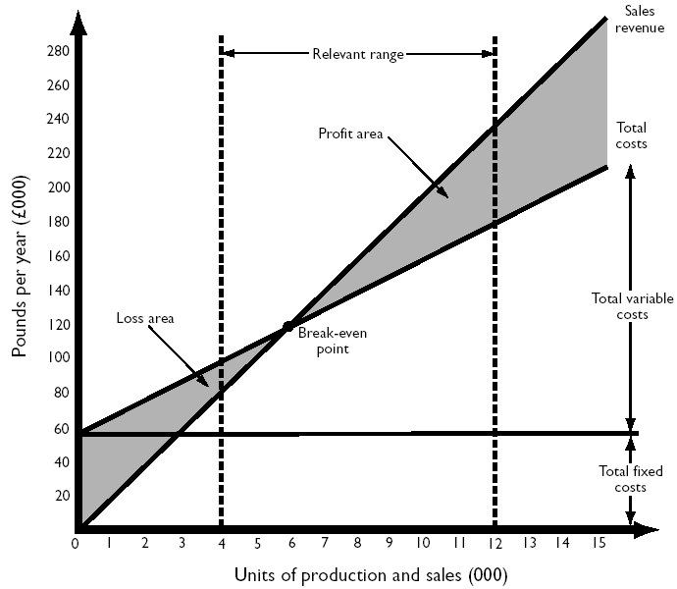
CVP analysis: non-graphical computations
Break-even
chart for
Example 1
drcetiner@gmail.com Prof. Dr. B. Gültekin Çetiner

Slide 14
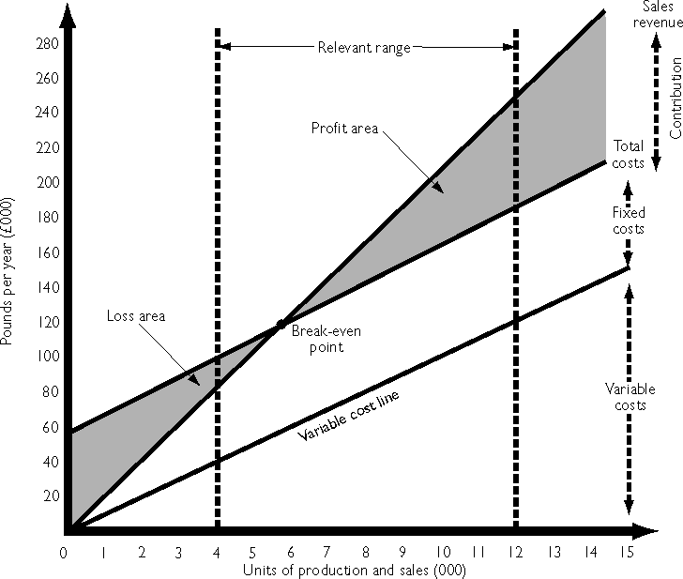
CVP analysis: non-graphical computations
Contribution
Chart for
Example 1
drcetiner@gmail.com Prof. Dr. B. Gültekin Çetiner

Slide 15
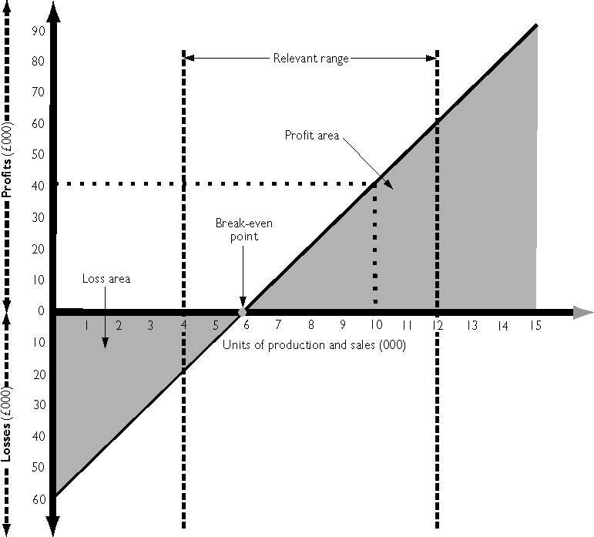
CVP analysis: non-graphical computations
Profit-volume
graph for
Example 1
drcetiner@gmail.com Prof. Dr. B. Gültekin Çetiner

Slide 16
CVP analysis assumptions
1. All other variables remain constant
• e.g.sales mix, production efficiency, price levels, production methods.
2. Complexity-related fixed costs do not change.
• If the range of items produced increases but volume remains unchanged, then
it is assumed fixed costs will not alter.
3. Profits are calculated on a variable costing basis.
4. Unit variable cost and selling price are constant per unit of output.
5. The analysis applies over the relevant range only.
6. Costs can be accurately divided into their fixed and variable elements.
7. Single product or constant sales mix.
drcetiner@gmail.com Prof. Dr. B. Gültekin Çetiner

Slide 17
CVP analysis assumptions
Example (Constant Sales Mix)
Product X Product Y
Unit contribution £12 £8
Budgeted sales mix 50% 50%
Actual sales mix 25% 75%
Fixed costs are £180 000
Budgeted BEP = £180 000 /£10 (a) = 18 000 units
Actual BEP = £180 000 /£9 (b) = 20 000 units
ª (50% × £12) + (50% × £8)
^{b} (25% × £12) + (75% × £8)
drcetiner@gmail.com Prof. Dr. B. Gültekin Çetiner

Slide 18
Another example
For example, if your business has:
Fixed costs (FC) of $34,000
Makes sales and fees (S) of $120,000
With variable costs (VC) of $75,000.
Your contribution margin can be worked out according to the following formula:
(Sales - Variable Costs) ÷ Sales = Contribution Margin
(S - VC) ÷ S = CM
($120,000 - $75,000) ÷ $120,000 = 37.5%
Therefore, your contribution margin is 37.5% of sales, or $45,000. All your fixed costs must be paid for out of this 37.5% contribution margin.
drcetiner@gmail.com Prof. Dr. B. Gültekin Çetiner

Slide 19
Another example
For example, if your business has:
Fixed costs (FC) of $34,000
Makes sales and fees (S) of $120,000
With variable costs (VC) of $75,000.
To find out your break-even point (BE) you use the following formula and the percentage contribution margin figure:
Fixed Costs ÷ Contribution Margin = Break-Even Point
Using the same example, therefore your break-even point is worked out as follows:
FC ÷ CM = BE
$34,000 ÷ 37.5% = $90,666.
drcetiner@gmail.com Prof. Dr. B. Gültekin Çetiner

Slide 20
Another example
For example, if your business has:
Fixed costs (FC) of $34,000
Makes sales and fees (S) of $120,000
With variable costs (VC) of $75,000.
If you are happier using the dollar amount the formula becomes:
Fixed Costs ÷ Contribution Margin x Sales = Break-Even Point
FC ÷ CM x S = BE
$34,000 ÷ $45,000 x $120,000 = $90,666.
In other words, you must make sales and fees of approximately $91,000 before all your fixed and variable costs are met and your business is breaking-even and starting to make a profit.
drcetiner@gmail.com Prof. Dr. B. Gültekin Çetiner

Slide 21
Another example
For example, if your business has:
Fixed costs (FC) of $34,000
Makes sales and fees (S) of $120,000
With variable costs (VC) of $75,000.
Taking this a step further, it is also useful to know what your margin of safety is. This is the amount your total sales and fees can drop by before your business starts making a loss.
The margin of safety (MS) formula is:
(Sales - Break-Even Point) ÷ Sales = Margin of Safety
(S - BE) ÷ S = MS
Therefore:
($120,000 - $90,666) ÷ $120,000 = 24.4%
A high percentage figure is preferable as it indicates your business is achieving good sales/fees and incurring manageable levels of fixed and variable costs.
drcetiner@gmail.com Prof. Dr. B. Gültekin Çetiner

